Slide 1



Transform asset management, maintenance & operations —
IBM Maximo Application Suite NRTE Program – MAS Overview

Slide 2
Maximo Application Suite – NRTE Schedule
Session | Topics | Date | Presenter
Maximo Application Suite Overview | MAS + MAS-MS Overview & FAQs Parts/Packaging/CTL | May 21st, 2020 | Andrew Foster, Lauren Kang, Lisa Stuckless
Maximo Application Suite – Installation & Troubleshooting | Installation, footprint considerations, pre-requisites - Accessing the software in PPA - Support flows for underlining solutions - Troubleshooting | June 8th, 2020 | David Parker, Leonardo Tekatscz
Maximo Application Suite - Life cycle and Release Management | Overview of Release and lifecycle management fixpacks and ifixes | June 10th , 2020 | David Parker, Lisa Stuckless
Maximo Application Suite - Architecture Overview | MAS + MAS-MS topologies Overview of licensing and deployment | June 11th, 2020 | Ron Baker, Arlindo Chiavegatto
Maximo Application Suite - Offering Deep dive | Understanding Migration scenarios, usage, lab services, roadmap | June 17th, 2020 | PK Sridhar, Andrew Foster
Maximo Asset Monitor running in Maximo Application Suite | Basic Monitor overview with links to existing training materials How Monitor in MAS is different to Monitor SaaS Migration Scenarios for existing Monitor clients Troubleshooting and where to get help. | June 23rd, 2020 | Carlos Ferreira, Markus Mueller
Maximo Application Suite Managed Service - Offering Deep Dive | Introduction to MAS-MS Provisioning fundamentals MAS vs MAS-MS - what are the differences? Migration scenarios | June 24th, 2020 | Lauren Kang, Michael Kwok, Andrew Lee
Notes:
This presentation is part of a series of technical enablement events on Maximo Application Suite
Please subscribe to the rest of the series

Slide 3
Outline
Industry need and trends
Introducing the Maximo Application Suite
Benefits of using the Suite
What’s included in the Suite
Suite commercial aspects
FAQs and resources
Notes:
What’s changing Across industries…what are the challenges with Enterprise Asset Management today

Slide 4
Disclaimer Regarding Future Products
IBM’s statements regarding its plans, directions, and intent are subject to change or withdrawal without notice at IBM’s sole discretion.
Information regarding potential future products is intended to outline our product direction and it should not be relied on in making a purchasing decision.
The information mentioned regarding potential future products is not a commitment, promise, or legal obligation to deliver any material, code or functionality.
The development, release, and timing of any future features or functionality described for our products remains at our sole discretion.

Slide 5

The operating model in asset intensive industries is changing
Drone Inspection
15%-50%
Reduced Operational Cost
Real time remote monitoring
Predictive failure model
5%-10%
Increased Up time & Availability
Sensors
Up to 15%
Increased Asset Life
SCADA / Embedded System
Digital Twin
Notes:
The asset of the future includes several integral parts, as outlined on the slide, exponentially increasing the efficiency and transparency of your operations.
Sensors capture data, which are then housed in the cloud which then flow into Real Time Monitoring
Real Time Monitoring allows your to transparently see what your assets are doing, and how they are performing 24/7. This flows right into the Predictive Failure Model
Taking this data from sensors and RT Monitoring, Machine learning can develop a high grade of accuracy to predict failures and understand asset criticality, tying directly into MRO Inventory optimization and supply chain needs
Autonomous driver capabilities leverages sensors and onboard (edge) compute to decrease operational and safety risks, while optimizing productivity automatically
A fully functional digital twin is the result of all of this. It is a digital representation not only of your individual assets/equipment, but of your entire system and process. Digital twins allow you to effectively model operations, monitor every aspect of your operation, and optimize the output of your system. Digital twin will also enable better information sharing between parties, minimizing downtime, and creating effective communication amongst asset OEMs, owners, operators, and mainteners.

Slide 6
Daily challenges we hear from our clients
We want to decrease downtime...
We need to derive new value from data ...
We are losing our most experienced technicians…
30%
of the total workforce is retiring
$50B
Savings on unplanned downtime
82%
of asset failures appear randomly
99%
of data collected from sensor-enabled assets goes unused
37%
average turnover in the field workforce
30%
Reduction of maintenance activities
$170B
cost of safety incidents in US industries in 2019
70%
Hours Savings by preventive maintenance
Notes:
Sources: The industry is facing this problems
Many best-in-class organizations have shifted to the predictive maintenance approach, and as result their efficiency range is 90-95 percent. Source: https://www.manufacturing.net/blog/2017/10/why-your-company-does-not-need-invest-eam
30% of maintenance activities are carried out too frequently: .Oniqua Enterprise Analytics, Reducing the Cost of Preventative Maintenance, http://www.plant-maintenance.com/articles/PMCostReduction.pdf
Unplanned downtime costs industrial manufacturers an estimated $50 billion each year.
http://partners.wsj.com/emerson/unlocking-performance/how-manufacturers-can-achieve-top-quartile-performance/ (2017)
Optimizing your preventive maintenance workload can reduce total preventive maintenance hours by 50% to 70%.
Short link: https://ibm.co/apmstat6
82% of asset failures appear random: ARC view, Optimize Asset Performance with Industrial IoT and Analytics, August 2015 http://www-01.ibm.com/common/ssi/cgi-bin/ssialias?subtype=WH&infotype=SA&htmlfid=WWL12350USEN&attachment=WWL12350USEN.PDF
99% of rig data from sensors goes unused: McKinsey https://www.mckinsey.de/sites/mck_files/files/unlocking_the_potential_of_the_internet_of_things_full_report.pdf
170B cost of safety - https://injuryfacts.nsc.org/work/costs/work-injury-costs/
30% retiring - https://generalaviationnews.com/2018/02/20/mechanics-retiring-faster-can-replaced/
22-37% - https://www.manufacturing.net/labor/article/13228819/how-to-reduce-turnover-and-improve-productivity-on-the-manufacturing-floor

Slide 7

EAM Market and Business Drivers
Market Drivers
Increasing shift from efficiency to resiliency of operations
Support demand for increasing customization and experiences
Desire to realize the benefits of predicting failures
Business Drivers
Accelerate customers to modernize and transform with a fundamental improvement in how IBM packages, provisions and licenses application software
Use AI as a clear benefit from adopting a hybrid cloud strategy
Address long standing challenges around ease of use and ease of consumption
Provide flexible selling options that allow you to build new relationships with existing clients and go after new clients

Slide 8
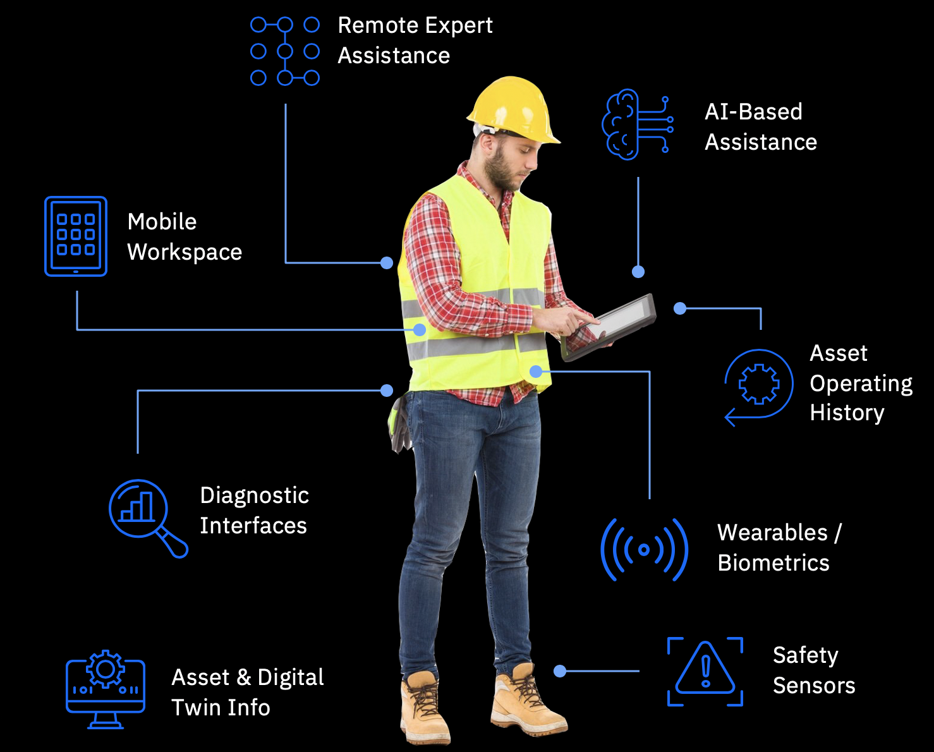
Reimagine operations with AI and predictive maintenance
New insights from assets
New ways of working
AI Anomaly or Alert
Generate Work Queue
Visual Inspection
Asset Health Score
Maintenance History
Predicted Failure
Notes:
Embedding AI across. Closed loop model
If you think about the digital transformation that’s occurring, combination of two gives you that. increased productivity and operational uptime. To achieve a complete view of asset lifecycle management, clients need to capture and analyze data from today’s intelligent assets in order to understand the full spectrum of preventive, predictive and prescriptive maintenance actions needed.
Al infused in existing business process

Slide 9
Journey to Predict
Visual Inspection
Predict
Visual anomaly detection
Use data to predict failures
Monitor
Health
Manage and detect anomalies
Manage
Health
Manage
Understand and manage maintenance
Digital Twin
1-click download
9
Notes:
Enabler across the entire journey
Gathering data and building your way to predict…

Slide 10
Introducing the next generation solution for Intelligent Asset Management, Maintenance and Operations Maximo Application Suite
Maximo 8.x

Slide 11









Purpose built to accelerate digital transformation
Manage
Intelligent asset management
Scheduler
Schedule work and resources
Monitor
Monitor and detect anomalies
Health
360-degree view of assets
Predict
Predictive failures
Mobile
Technician work execution
Assist Prescriptive assistance
Safety
Actionable insights for safety
Visual Inspection
Visual anomaly detection
Industry Accelerators
Tailored to your industry

Slide 12
SUBJECT TO CHANGE
Maximo Application Suite Roadmap
Maximo Application Suite 8.2
Application Suite Components
Monitor
Health
Predict
Assist
Maximo Application Suite 8.3.x
Application Suite Components
Manage(EAM)
Mobile
Monitor
Health
Predict
Assist
Safety
OFFERING LAUNCH
Maximo Application Suite 8.0
Application Suite components
Monitor
Manage – Entitlement to Maximo
Technician
Inspections
Offline
Mobile
Scheduler
Visual Inspection
May 29th
Sept 18th
March 30th
Jan
Feb
Mar
Apr
May
Jun
Jul
Aug
Sept
Oct
Nov
Dec
Jan
Feb
Mar
Apr
May
Jun
Jul
2020
July 31st
Dec 15^{h}
2021
July 31st
Maximo Application Suite 8.1
Health
Predict
Application Suite Components
Monitor
Maximo Application Suite 8.3
Manage(EAM)
Scheduler
Safety
Maximo Visual inspection
Assist
Monitor
Health
Predict
Application Suite Components
Maximo Application Suite 8.3.x
Application Suite Components
Manage(EAM)
Monitor
Health
Predict
Assist
Safety
Configuration
Service Request
Mapping
Mobile
Scheduler
Visual Inspection
Notice: IBM’s statements regarding its plans, directions, and intent are subject to change or withdrawal at IBM’s sole discretion. Information regarding potential future products is intended to outline our general product direction and it should not be relied on in making a purchasing decision. The information mentioned regarding potential future products is not a commitment, promise, or legal obligation to deliver any material, code or functionality. Information about potential future products may not be incorporated into any contract. The development, release, and timing of any future features or functionality described for our products remains at our sole discretion.

Slide 13


Built to scale your digital transformation journey
Integrated Solution
Simplified Licensing
Multi-Cloud Deployment
Notes:
Suite is an existing concept…1 contract 1 pricing model and use any

Slide 14
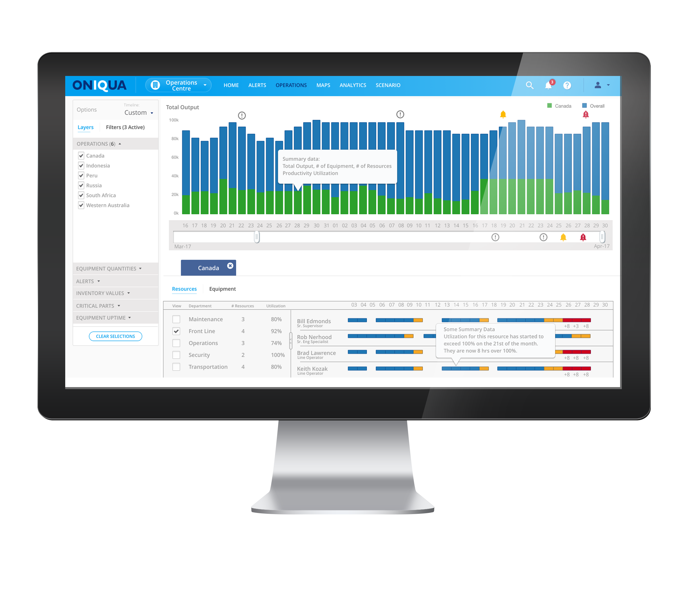
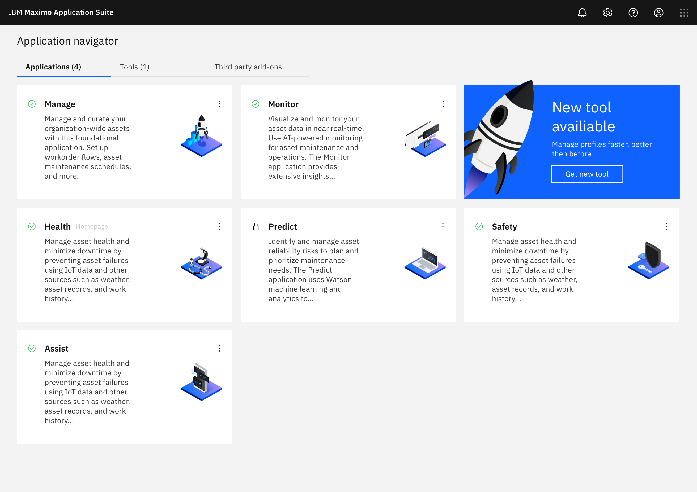
Start anywhere and scale your digital transformation journey
Integrated Suite of Applications
Notice: IBM’s statements regarding its plans, directions, and intent are subject to change or withdrawal at IBM’s sole discretion. Information regarding potential future products is intended to outline our general product direction and it should not be relied on in making a purchasing decision. The information mentioned regarding potential future products is not a commitment, promise, or legal obligation to deliver any material, code or functionality. Information about potential future products may not be incorporated into any contract. The development, release, and timing of any future features or functionality described for our products remains at our sole discretion.
14
Notes:
Single integrated platform, Enhanced data sharing, Easy to try new applications
Modern componentized architecture built for scale and availability
Notes: Data sharing focus; single source of data, Value add vs not, Focus on problems not data plumbing, You can capture everything faster, more effectively, resilient decision making in your Operations
Enhanced user experience with single sign-on, increased data sharing, and application integration
Everything is integrated and available: no additional procurement/installation for new apps

Slide 15
Maximo Application Suite Benefits
-
Single license
One entitlement to entire Suite
Simplified Licensing and Usage
Flexible consumption
Sharing of license through concurrent users
Simplified usage
Access any app without additional provisioning
15
Notes:
Example 1: Core Maximo users will be a basic user type and will be able to use a single user license to access any of the applications (roles) that are support basic user type (majority)
Example 2: Technicians will user a Limited user type
====
Simplified licensing structure: Through committed term licenses with single entitlement for all apps
Shared pool of points: Tokens purchased can be used across applications, shift usage across apps as needed
Get more from your EAM Investment: Start with what you need and pay only for what you use
Provides increased flexibility and lower cost of entry
A shared pool of points leveraged by all Suite applications makes it easier to try new capabilities
A unified account to access and navigate across the apps
Monitor and track usage across
Get more of your EAM
We are delivering it using a new simplified licensing model where you purchase user-based seats to the suite with the ability to leverage ANY of the solutions in the suite. That is correct, you can access any of the solutions in the suite.

Slide 16


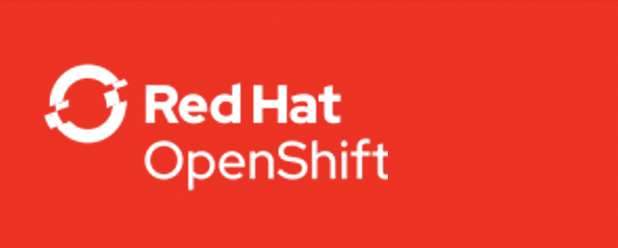

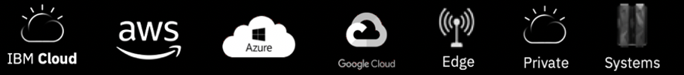
Maximo Application Suite Benefits
Suite Applications
Manage
Intelligent asset management
Scheduler
Schedule work and resources
Monitor
Monitor and detect anomalies
Health
360-degree view of assets
Predict
Predictive failures
Multi-Cloud Deployment
Mobile
Technician work execution
Assist Prescriptive assistance
Safety
Actionable insights for safety
Visual Inspection
Visual anomaly detection
IBM Cloud Pak for Data | IBM Watson Studio | IBM Watson ML | DB2
Infrastructure Independent
Common Operating Environment
Notice: IBM’s statements regarding its plans, directions, and intent are subject to change or withdrawal at IBM’s sole discretion. Information regarding potential future products is intended to outline our general product direction and it should not be relied on in making a purchasing decision. The information mentioned regarding potential future products is not a commitment, promise, or legal obligation to deliver any material, code or functionality. Information about potential future products may not be incorporated into any contract. The development, release, and timing of any future features or functionality described for our products remains at our sole discretion.
16
Notes:
Built on the Red Hat OpenShift Container Platform: for optimized scale and availability on on-premises, private and public clouds, or hybrid environments
Customer managed: Purchase MAS and deploy in the environment of your choice
IBM Managed: Purchase MAS and hosting, and let IBM’s trusted team take care of everything for you
Easy to install
Point to RHOS, Cloud Pak slide in backup, make it meaningful to Maximo customers (Other benefits)
All of these solutions are being delivered together in what we are calling Maximo 8.0 run on the IBM cloud powered by OpenShift. It operates with your existing Maximo installation.

Slide 17
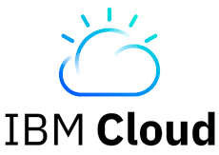
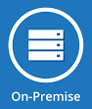
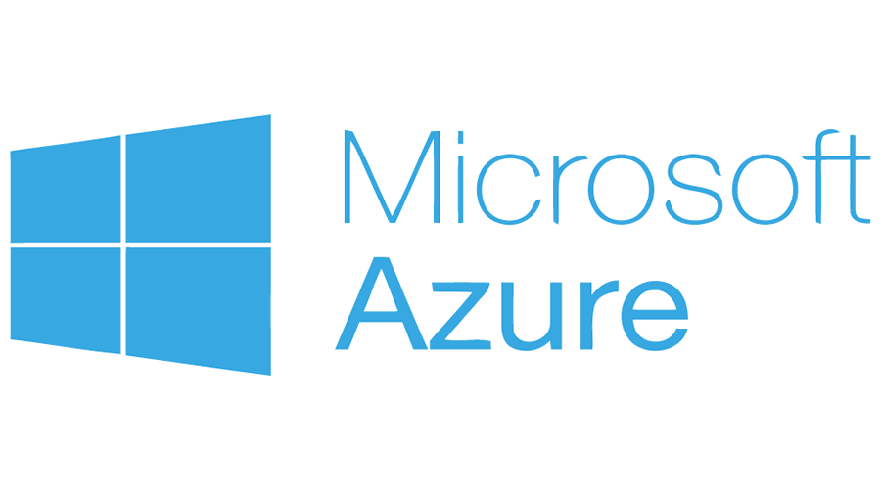

Two deployment options for maximum flexibility
With single entitlement to all applications available via Committed Term Licenses
Managed by You
Managed by IBM
Purchase software only
Host it in the cloud or environment of your choice
Purchase software and hosting fees
Let IBM’s trusted team take care of hosting for you
Maximo Application Suite
Maximo Application Suite
Applications
Applications
App A
App A
App B
App C
App B
App C
Common Components
Common Components
Customers
install & operate
IBM
installs & operates
Notes:
Suite is an existing concept…1 contract 1 pricing model and use any

Slide 18
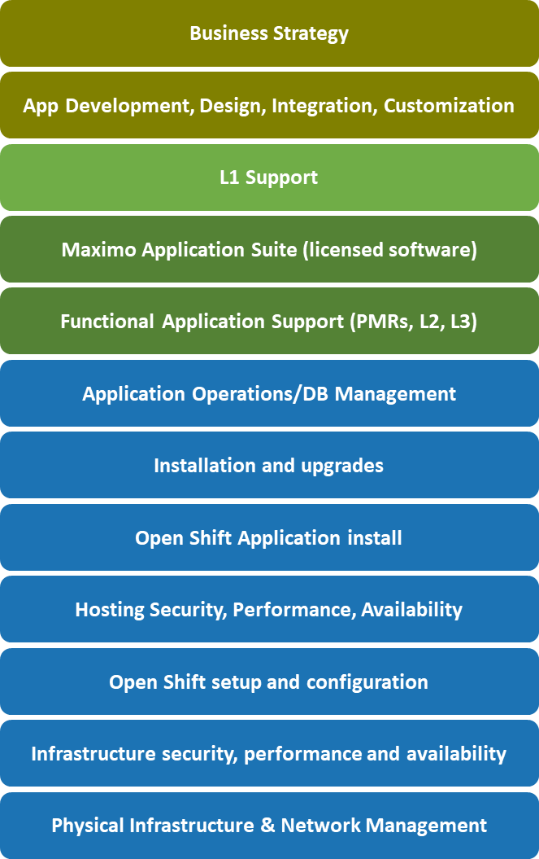
Maximo Application Suite Managed Service
Managed Service is a separate offering from the MAS Software
Managed Service Roles & Responsibilities
MAS Software
(CTL)
MAS
Managed Service
App Points
Managed Service
VPC
Managed Service
Data
Separate purchase of an ‘as a service’ offering

Slide 19
MAS Managed Service Operations
Parameters | Descriptions
Supported DataCenters | Dallas Washington DC (EAM Saas Flex) Frankfort London (EAM Saas Flex) Sydney (EAM Saas Flex) Tokyo
Availability Service Level Agreement | Availability Agreement (production) Availability less than 99.9 = 2% credit Availability less than 99.0 = 5% credit Availability less than 95.0 = 10% credit
Backup / Recovery Objectives | Backups are performed 7 days a week Backups are replicated to a remote (secondary) IBM Cloud data center daily Retention is 31 days for production and 7 days for test/dev environment
Disaster Recovery Objectives | Standard Only: Backups to secondary site with no application or DB RPO = 24 hrs RTO = 72 hrs
Service Level Response Times Objectives | Severity | Response Time | Coverage Sev 1 | Within 1 hour | 24x7 Sev 2 | Within 2 Hours | M-F Business hours Sev 3 | Within 4 hours | M-F Business hours Sev 4 | Within 1 business day | M-F Business hours

Slide 20
Introducing Committed Term Licenses Strategic direction for Maximo offerings
Maximo Application Suite
Client Benefits
Lowers the cost of entry
Provides increased flexibility
Align to Red Hat subscription model
Passport Advantage contract familiarity
Price protection with longer contract length
Possibly leverage Opex and not just Capex.
Seller Benefits
Easier to get a customer to purchase with a smaller committed investment
The suite itself contains multiple functions, what would have otherwise been separate parts to sell. Automatic seeding and expansion opportunities.
Attain quota on transactional revenue
IBM Benefits
Align to market expectations
Transform IBM to a subscription-based business model
Align with existing management system
Degree of customer commitment
Term Licenses
(uncommitted)
*Committed Term Licenses*
(committed)
Perpetual Licenses
OpEx Model
CapEx Model
License model specifics
New part numbers for Committed Term License
Minimum 12-month commitment, Maximum 60 months.
Cannot cancel during term period
Notes:
Term – Rent the Car
CTL – Lease the Car
Perpetual – Buy the Car
Can do monthly after 12 mth min – 13 mths – 27 mths etc…

Slide 21
Upgrade to MAS Committed Term License
Maximo Application Suite
Maximo as a Committed Term License
An Upgrade to a Committed Term License:
Brings a client from a perpetual license with active Subscription and Support (S&S) to MAS as a Committed Term License
Enables a clients to leverage existing IBM investment for our new generation of products that represent the latest and greatest IBM technologies
By moving a client from an S&S model to a Committed Term License model, IBM can add MORE value to their existing entitlements over time, ensuring they stay current and on the forefront of innovation
Cannot upgrade with an FCT part – must move to PA first
Added Value
Added value comes in the form of:
New features
New capabilities
More flexibility
Eligible Program
Perpetual Product with Active S&S
Min. 35% Uplift on Last Price Paid S&S
Client makes an incremental investment for significant value
All Upgrades to Committed Term License MUST go through the AI Application Suite Project Office
IBM Watson IoT / © 2020 IBM Corporation
21

Slide 22
Parts & Pricing
Maximo Application Suite
IBM Maximo Application Suite - PID 5737-M66
Committed Term License - Minimum 12 month purchase – non cancelable)
Description | Part Number | Names | Price | Metric | Comments
MAS Software Part | D28B4LL | IBM Maximo Application Suite | $100 | AppPoint | Monthly Part
MAS Upgrade – Restricted (term upgrade part from perpetual) | D28B5LL | IBM Maximo Application Suite UpGrade Perpetual | $44 | AppPoint | Monthly Part – 35% Uplift required
Notes:
Notes: Must obtain pricing slide for the offering’s pricer. Different levels of information are expected depending on the playback. See the detailed guidance referenced above.

Slide 23
Pricing: MAS AppPoints will be used across suite One entitlement covers the whole suite. AppPoints are expended based primarily upon different active User types
Maximo Application Suite
Committed Term License
for single entitlement to entire suite (all capabilities)
CTL pool of AppPoints
One Entitlement; One Pool of AppPoints
Customer buys a pool of AppPoints for the Suite via a single CTL part
For the length of Term, the customer can use those AppPoints across the Suite
Different user types have access to different function and have different AppPoints they consume upon login based upon their user type.
There are some components that are not user based (install/server components) that consume AppPoints.
New use cases will be added over time
Requires an LKS server for AppPoints
units available for use
Maximo Application Suite
units
Manage
Monitor
Health
Predict
Future Features
Value Based licensing - user consumes more AppPoints based on increased solution access
Premium User type - 15 AppPoints (Manage Ind. Solutions, Predict)
Base User type - 10 AppPoints (Manage full access, Health)
Limited User type - 5 AppPoints (Manage 3 modules, Monitor)
Install type - 1 AppPoint x multiplier (Manage ERP Adapter, Manage Spatial)

Slide 24
New Licensing Model Concurrent User Type – AppPoint Allotment
Maximo Application Suite
Self-service remains free – no AppPoints required
Concurrent User | Limited (5) | Base (10) | Premium (15) | Notes
Maximo Manage Limited | ✔️ | ✔️ | ✔️ | Any 3 EAM Manage modules (cannot be Scheduler/Plus, Administration, Integration, System Config, Security) Ability to view reports, change status and update work orders in any module (former Express capability). Includes Linear, Calibration, Spatial
Linear | ✔️ | ✔️ | ✔️
Calibration | ✔️ | ✔️ | ✔️
Spatial | ✔️ | ✔️ | ✔️ | Spatial Users, Install is separate
Anywhere | ✔️ | ✔️ | ✔️ | Includes 3rd party mobile
Industry Solution Limited | ✔️ | ✔️ | ✔️ | Includes EAM Industry Solutions, MSP, ACM & HSE
Monitor | ✔️ | ✔️ | ✔️
Maximo Manage |  | ✔️ | ✔️ | Includes Linear, Calibration, Spatial
Scheduler/Plus |  | ✔️ | ✔️ | Includes Scheduler, Scheduler Plus and Graphical Appointment Book functions
Health, Assist, Safety |  | ✔️ | ✔️ | Future Releases
Manage Industry Solutions |  |  | ✔️ | Access to all EAM Industry Solutions (except Life Sciences - Calibration is now part of Manage)
Asset Configuration Manager |  |  | ✔️
Managed Service Provider |  |  | ✔️
Health, Safety and Environment |  |  | ✔️
Predict |  |  | ✔️ | Future Release

Slide 25
New Licensing Model Administrator User – AppPoint Allotment
Maximo Application Suite
Concurrent Users | Limited (5) | Base (10) | Premium (15) | Notes
Application |  | ✔️ | ✔️ | Lets the user be set as an administrator in any of the applications they have access to. What that means specifically is unique to each application. For example. an EAM Administrator has access to Administration, Integration, System Config and Security modules.
Workspace |  | ✔️ | ✔️ | Lets a user add users to a workspace, remove them from that workspace and determine their levels of access within that workspace and its applications.
Suite |  |  | ✔️ | System Administrator: a technical user that manages the MAS system; enable/disable applications, change the configuration of services and install/replace the license key file.
Administrators are defined users in the system
Customers can “reserve” a certain number of AppPoints to ensure Admins always have access
Admins can access all Suite functionality, regardless of group.
Example: A Manage administrator is tagged as an Application Admin User - and withdraws 10 AppPoints. That admin can access and administer Predict, which is in the Premium group.

Slide 26
New Licensing Model Server/Install – AppPoint Allotment
Maximo Application Suite
Server/Install | AppPoints | Notes
SAP Adapter | 80 | Removed from pool at Suite start-up once online.
Oracle Adapter | 80 | Removed from pool at Suite start-up once online.
Spatial Install | 20 | Removed from pool at Suite start-up once online.
Server/Install work differently.
They have various number of AppPoint entitlement requirements.

Slide 27
Proposed Maximo Application Suite License model - User has access to use all products in the level
Premium Concurrent User - 15 AppPoints
Manage Industry Solutions
Predict (Future Release)
Trans.
Nuclear
Utilities
Oil & Gas
Aviation
Civil Infras.
ACM
MSP
HS&E
Base Concurrent User - 10 AppPoints
Manage (full access)
Scheduler/Plus
Health
(Future Release)
Spatial
Linear
Cali
Assist
(Future Release)
Safety
(Future Release)
Limited Concurrent User - 5 AppPoints
Manage/Ind. Solutions (3 modules)
Manage Mobile user
(Anywhere/3rd party)
Monitor
Spatial
Linear
Cal
Install - 1 AppPoint (x multiplier)
Manage ERP Adapter for SAP/Oracle (x80)
Manage
Spatial (x20)
27

Slide 28
Maximo EAM to Maximo Application Suite
Is this an Existing Maximo Customer?
(Perpetual, Token, SaaS)
Do they want other Suite functionality?
(Monitor, Health, Predict)
Yes
Are they moving to CTL Model
( Suite AppPoints, OpenShift)
Yes
Upgrade to Suite Customer
Start
Yes
No
Not Yet
Not Yet
New footprint
Phased Approach
Coexistence
Buy CTL Part; Deploy Suite
Remain on Existing License Entitlement for now
(Perpetual, Tokens, SaaS)
EAM remains on current license entitlement and integrates with Suite, similar to a 3rd Party App.
EAM upgrade to CTL entitlement; Deploys OpenShift Suite Components
Suite AppPoints
License Key Server deployed within OpenShift.
No Changes. Existing Token customers continue to use current Fixed Term Entitlement & Maximo Tokens.
For Maximo Perpetual & SaaS customers: No change to existing Maximo.
Maximo Token customers: maintain two non-interoperable Flexera LKS instances. Users pull from one or the other LKS depending on function they’re using. No interchangeability between Maximo tokens and Suite pts.
For Maximo Perpetual, use CTL Upgrade part.
SaaS & Token customers can run out contracts or reset on CTL
Maximo Token customers: Point to new Suite LKS; No more use of Maximo tokens. All Suite ‘point’ based.
Implications:
IBM Watson IoT / © 2020 IBM Corporation
28

Slide 29
Client Example – Net New Client IBM Maximo Application Suite - Part Number D28B4LL
Maximo Application Suite
Concurrent Users | Quantity | Category | AppPoints | Comments
Maximo Manage | 25 | Base | 25 * 10 = 250 | EAM Concurrent Authorized
Scheduler | 20 | Base | 10 * 0 = 0 | Scheduler part of Manage Base
Maximo Manage Limited | 75 | Limited | 75 * 5 = 375 | EAM Concurrent Limited or Express users
Spatial | 100 | Limited | 100 * 0 = 0 | Spatial part of Manage Limited
Spatial Install | 1 | Install | 1 * 20 = 20 | Install - removed during startup
Anywhere | 100 | Limited | 100 * 5 = 500 | Mobility Users
Monitor | 5 | Limited | 5 * 0 = 0 | Part of Limited - Are they the same Concurrent Users as Maximo Manage Ltd?
Application Administrator | 10 | Base | 10 * 10 = 100 | Pre-Reserved for Administrators
Suite Administrator | 2 | Premium | 2 * 15 = 30 | Pre-Reserved for Administrators
Total AppPoints = 1,275
AppPoints: Limited = 5, Base = 10, Premium = 15

Slide 30
Client Example – Upgrade From Perpetual IBM Maximo Application Suite Upgrade Perpetual - Part Number D28B5LL
Maximo Application Suite
Users | Quantity | Category | AppPoints | Comments
Utilities Authorized | 2036 | Premium | 2036/3 * 15 = 10,180 | Industry Solution Premium users
HSE Authorized | 42 | Premium | 42 * 0 = 0 | HSE users would already be Utilities users
Scheduler | 125 | Base | 10 * 0 = 0 | Scheduler part of Manage Base. Premium user have access
Asset Management Express | 500 | Limited | 500/3 * 5 = 833 | Express part of Manage Limited. Different users from Authorized
Total AppPoints = 11,013
LPP USD Extended Price | Last Price Paid S&S with 35% Uplift | Entitled Price of MAS CTL Upgrade Entitlements x $44 Monthly CTL Rate x 12 | Discount Required on CTL Upgrade to match LPP + 35% Uplift
$1,096,098.41 | $ 1,479,733 | $ 5,814,864 | 75%
AppPoints: Limited = 5, Base = 10, Premium = 15

Slide 31
MAS Managed Service:- Parts and List Price
These parts do not include the MAS software
These three parts are “building blocks” to each customer’s deployment.
Each customer’s deployment will require some combination of multiples of these three parts, depending on how they’re using MAS
Example:
Customer A’s deployment may require:
Customer B’s deployment may require:
Managed Service Unit | 4
VPC | 17
Data | 2450
Managed Service Unit | 17
VPC | 111
Data | 5400

Slide 32
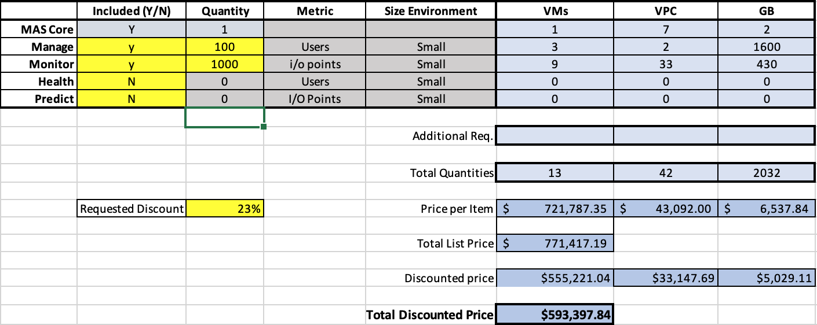
MAS Managed Service:- Pricing a Deal
Calculator for Sales has inputs for which apps customer wants to deploy
Enter the quantity of the ‘cost driver’
List price is generated
Requested Discount defines Sale Price*
*Subject to GP requirements

Slide 33
Call to Action
Maximo Application Suite
Bring deals to the Project Office for review.
Deep Dive on pricing and packaging – May 28th 9am EST (90minutes)
Upgrades: Start early – work with your S&S sellers to target upcoming S&S renewals for Upgrades to MAS as a Committed Term License.
Lead with Net New Committed Term Licenses as your default go-to-market strategy for Maximo – especially in competitive situations. The longer the term, the higher the earnings opportunity!

Slide 34
Parts & Packaging Resources
Maximo Application Suite
Project Office
Jaideep Randhawa - jsrandha@us.ibm.com
Chris Vetor - cvetor@us.ibm.com
SW Pricer
Deb Shuck - dshuck@us.ibm.com
Offering Managers for Maximo Application Suite
Lisa Stuckless - lss@ca.ibm.com
Kim Woodbury - kwoodbur@us.ibm.com
Dave Gasdia - drgasdia@us.ibm.com
PK Sridhar - psridhar@us.ibm.com
Andrew Foster – andrew.foster@uk.ibm.com
Offering Managers for Managed Service
Michael Kwok - mkwok@us.ibm.com
Lauren Kang - Lauren.J.Kang@ibm.com
Andrew Lee - lee1a@us.ibm.com

Slide 35
Maximo Application Suite – Adding more material as we get closer to GA Maximo Manage – Enterprise Asset Management EAM Maximo Monitor - Asset Monitor Maximo Health - Asset Health Insights Maximo Predict – Predictive Maintenance Maximo Assist – Equipment Maintenance Assistant Maximo Safety – Worker Insights
Additional Resources: Links to Sales Kits
#ask-maximo-suite
35

Slide 36
Maximo Application Suite – NRTE Schedule
Session | Topics | Date | Presenter
Maximo Application Suite Overview | MAS + MAS-MS Overview & FAQs Parts/Packaging/CTL | May 21st, 2020 | Andrew Foster, Lauren Kang, Lisa Stuckless
Maximo Application Suite – Installation & Troubleshooting | Installation, footprint considerations, pre-requisites - Accessing the software in PPA - Support flows for underlining solutions - Troubleshooting | June 8th, 2020 | David Parker, Leonardo Tekatscz
Maximo Application Suite - Life cycle and Release Management | Overview of Release and lifecycle management fixpacks and ifixes | June 10th , 2020 | David Parker, Lisa Stuckless
Maximo Application Suite - Architecture Overview | MAS + MAS-MS topologies Overview of licensing and deployment | June 11th, 2020 | Ron Baker, Arlindo Chiavegatto
Maximo Application Suite - Offering Deep dive | Understanding Migration scenarios, usage, lab services, roadmap | June 17th, 2020 | PK Sridhar, Andrew Foster
Maximo Asset Monitor running in Maximo Application Suite | Basic Monitor overview with links to existing training materials How Monitor in MAS is different to Monitor SaaS Migration Scenarios for existing Monitor clients Troubleshooting and where to get help. | June 23rd, 2020 | Carlos Ferreira, Markus Mueller
Maximo Application Suite Managed Service - Offering Deep Dive | Introduction to MAS-MS Provisioning fundamentals MAS vs MAS-MS - what are the differences? Migration scenarios | June 24th, 2020 | Lauren Kang, Michael Kwok, Andrew Lee

Slide 37
Thank you.
Q&A

Slide 38
FAQs
Maximo Application Suite
Maximo Asset Management – Moving Forward
Maximo 760x – Announce EOM/EOS Sept 2020 with 12 months to Sept 2021
Maximo 761x – Minimal Feature Packs available through EOM/EOS announce in 2023 with 12 months to 2024
New capabilities for Maximo will be delivered via MAS only.
New licenses can still be purchased for existing customer.
How do I sell Tokens and SaaS ?
Do not stop any Token deals in flight.
After MAS announce start new opportunities using CTL.
For SaaS clients we are moving towards a Managed Service offering.
After MAS announce start new opportunities with Managed Service
Token and SaaS Flex deals would run to term and then sell CTL.
SaaS Public will be EOM/EOS in Q32020
Monitor – Moving Forward
Do not stop any deals in flight
At announce start new opportunities with CTL

Slide 39
FAQs
Maximo Application Suite
Are AppPoints required for other types of Integration?
Currently no AppPoints are required for other type of integrations outside of 3rd party mobility.
If they are populating Work Order Tracking from 3rd party require Limited
SAP/Oracle are available with AppPoints
Can I use Tokens and Appoints together?
No - the Token and AppPoint server are not interchangeable.
LKS server is embedded in the Suite and is required to check in and check out AppPoints.
System Requirements for MAS
Link to provisioning guide that outlines the pre-reqs and instruction for provisioning https://supportcontent.ibm.com/support/pages/ibm-maximo-application-suite-system-requirements
Is there a demo instance we can get (internal) access to ?
Limited set of demo instance is planned closer to eGA time frame. We are working with CTP teams to broaden access post eGA

Slide 40
FAQs
Maximo Application Suite
Token Renewals vs CTL Renewals
Token: Currently when token deals are renewed, they are seen as new deals and retire quota etc,
CTL: No firm documentation on how Committed Term Licenses will be treated in terms of revenue recognition/quota retirement in 2021, as sales plans and targets for 2021 are not finalized. Stay tuned…
ELA
Catalogs and Unlimited Agreements - no you cannot have CTL parts in these agreements.
Price x Quantity - yes you can have CTL parts sold on a PxQ basis to an ELA customer (outside a catalog or unlimited)
Sales Comp
Still being worked on.

Slide 41
FAQs
Maximo Application Suite
Production versus Non-Production AppPoint Requirement?
For non-prod environments AppPoints are required.
For MAS 8.0 release Prod and Non-prod are in different MAS instances, so they have different License key server that users check in and out of.
No double-counting occurs for the same user having different browser sessions for Prod or Non-Prod.
Development working on no ‘double-counting’ for future release for Prod/Non-Prod.
I do not want OpenShift can I still use MAS?
No - the solution is built on OpenShift Container Platform

